Slide 1
Towards Facilitating the Removal of Software Vulnerability
Dongliang Mu
Pennsylvania State University
Notes:
Thank Prof XXX very much for the warm welcome and introduction.
Hello everyone, my name is Dongliang Mu. Today, I will talk about my research Towards Facilitating the Removal of Software Vulnerability.

Slide 2

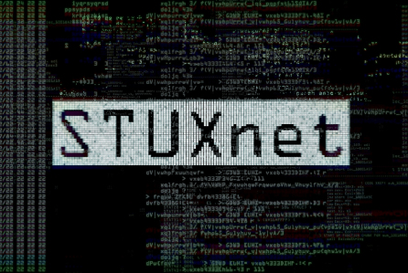


Cybersecurity Attacks Caused By Vulnerabilities
Stack Clash
Double Kill
Java Deserialize
Double Fetch
Notes:
Despite the best efforts of software developers, software systems inevitably contain security vulnerabilities. In the real world, those security vulnerabilities lead to many severe and notorious cyberattacks, such as Stuxnet, WannaCry Ransomware, HeartBleed. Take WannaCry Ransomware as an example, in 2017, unpatched vulnerabilities allowed the WannaCry ransomware to shutdown more than 300,000 computers around the globe. Therefore, security vulnerabilities are posing serious threats to users, organizations, and even nations.

Slide 3
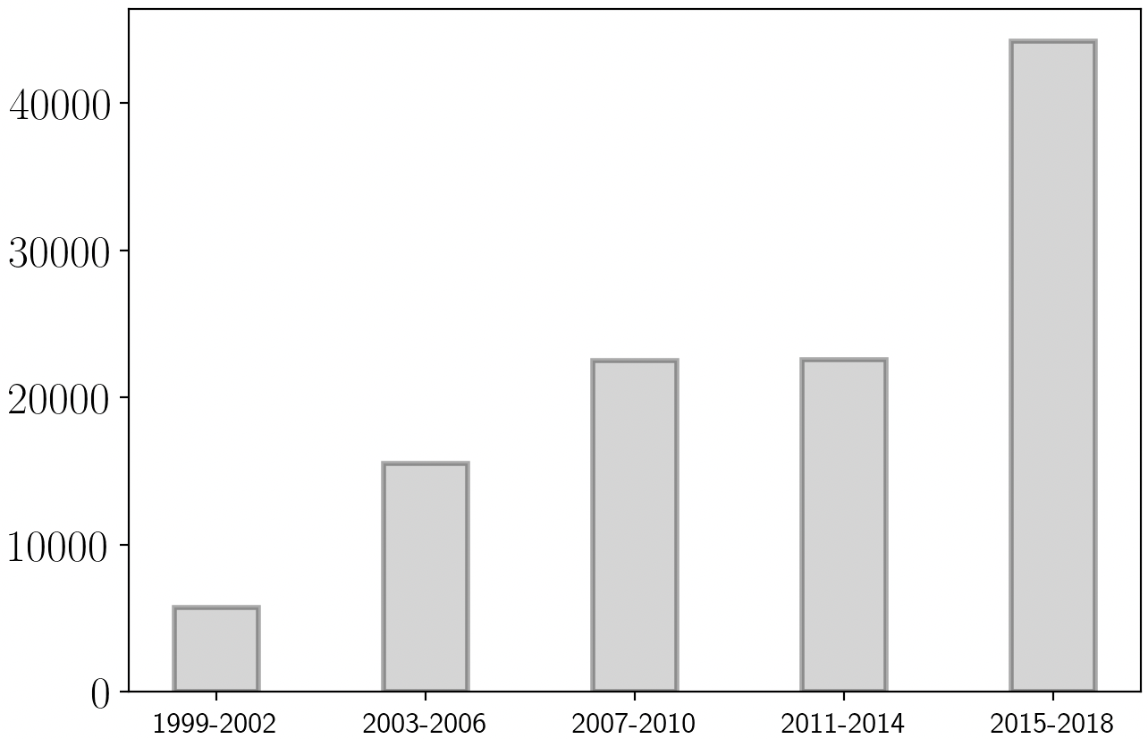
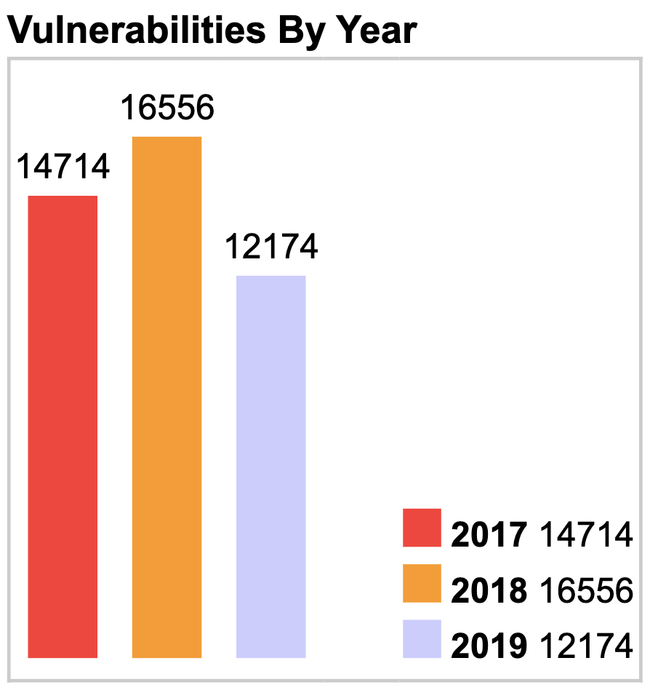
Massive Vulnerabilities Reported Over Time
44201
Common Vulnerabilities and Exposures
TOTAL CVE Entries: 130,093
22540
22589
33.4%
15523
5747
The Number of vulnerabilities reported to CVE by Year
Notes:
The above figure shows the number of vulnerabilities reported to CVE website per four years. From the figure, we can see the vulnerabilities reported per four years increases quickly, especially from 2014 to 2015. And the total CVE entries reported in twenty years is over one hundred and thirty thousand. The most important is, vulnerabilities reported in recent three years account for 33.4% in the whole dataset. To be summarized, vulnerability is prevalent in the real world and increasing significantly over time.

Slide 4

Problem Statement
Problem : How to remove all the possible vulnerabilities and make software systems more secure and reliable?
Vulnerability Discovery
Vulnerability Diagnosis
Vulnerability Patching
Efficiency
Effectiveness
Notes:
Therefore, one question comes into our mind: how to remove all the possible vulnerabilities and make software systems more secure and reliable. The most practical approach is to discover as many software vulnerabilities as possible, then diagnose them and finally patch them. In each step, we emphasize the efficiency and effectiveness, which means we need to accurately resolve problems in a timely manner as attackers may launch a cyberattack in any step.

Slide 5
Overview of Solution
Vulnerability Discovery
Hardware-assisted binary fuzzing
Hardware Feature (AsiaCCS’19)
Testing teams cannot discover all possible vulnerabilities before a software release
White-hat Hackers
Security Analysts
Security Researchers
……
Normal Users
The Crowd
Notes:
In the step of vulnerability discovery, software vendors set up testing teams and employ various testing techniques to identify vulnerabilities. Fuzz testing is the de facto automated software testing technique. In order to identify vulnerabilities more efficiently, I designed a hardware-assisted fuzzing tool which leverages a hardware feature to improve the performance of binary-only fuzzing and explore new code space. However, the problem is not solved as fuzzing needs significant time and lots of computation resource to perform effectively. Even worse, modern software systems are becoming more complex, and release cycles are getting shorter, testing teams cannot discover all the possible vulnerabilities before a software release. Therefore, an increasing number of software vendors have begun to rely on the power of the Crowd (i.e., any software users on the Internet) for vulnerability discovery.

Slide 6

Overview of Solution
My work mainly focuses on diagnosing software failures automatically to facilitate the vulnerability removal
Vulnerability Discovery
Vulnerability Diagnosis
Hardware-assisted binary fuzzing
Hardware Feature (AsiaCCS’19)
Understanding the Reproducibility of Vulnerabilities
Crowdsourcing (USENIX Security’18)
Vulnerability Reproduction
Root Cause Diagnosis
Facilitating Automatic Software Failure Diagnosis
Program Analysis (ACM CCS’16, TSE’19)
Hardware Feature (USENIX Security’17)
Deep Learning (USENIX Security’19, ASE’19)
Software Failures
The Crowd
Notes:
However, no matter vulnerabilities are discovered by testing teams or reported by the Crowd, Vulnerability Diagnosis follows two steps: 1. software developers try to reproduce and identify vulnerabilities following the reports; 2. software developers diagnose the root causes of those vulnerabilities. However, the vulnerability reproduction, as a critical early step for vulnerability patching, has not been well understood. Meanwhile, it is hard to diagnose software failures since crash reports are massive and only have limited information. Therefore, my work during the Ph.D. study mainly focuses on diagnosing software failure to facilitate the vulnerability removal. To be specific, I conducted the first empirical analysis of real-world security vulnerabilities with the goal of quantifying their reproducibility. In addition, I developed several automatic systems with program analysis, hardware features, and deep learning, to facilitate the work of developers in pinpointing the root causes of software failures.

Slide 7

Overview of Solution
Vulnerability Discovery
Vulnerability Diagnosis
Vulnerability Patching
Hardware-assisted binary fuzzing
Hardware Feature (AsiaCCS’19)
Understanding the Reproducibility of Vulnerabilities
Crowdsourcing (USENIX Security’18)
Facilitating Automatic Software Failure Diagnosis
Program Analysis (ACM CCS’16, TSE’19)
Hardware Feature (USENIX Security’17)
Deep Learning (USENIX Security’19, ASE’19)
Notes:
Finally, with understanding the details of one vulnerability, software developers could generate patches, and release those patches after quality assurance or patch testing. We will take this step as our future work and talk more later.

Slide 8
RoadMap
Background & Motivation
Vulnerability Diagnosis
Understanding the Reproducibility of Vulnerabilities (USENIX Security‘18)
POMP: Hardware-assisted Software Crash Analysis (USENIX Security’17)
Other Research
Conclusion & Future Work
Notes:
Due to limited time, I will only talk about research works on vulnerability diagnosis. In the rest of my talk, I will follow this roadmap. First, let me introduce some background.

Slide 9
Where does Software Failures Comes From?
Software Vendors Encourage Vulnerability Reporting
Software Vendors Automatically Collect Crash Reports
Notes:
As mentioned before, testing teams cannot find out all the possible vulnerabilities before a software release. Software vendors get software failures from two different sources: First, software Vendors Encourage Vulnerability Reporting; Second, software Vendors Automatically Collect Crash Reports

Slide 10









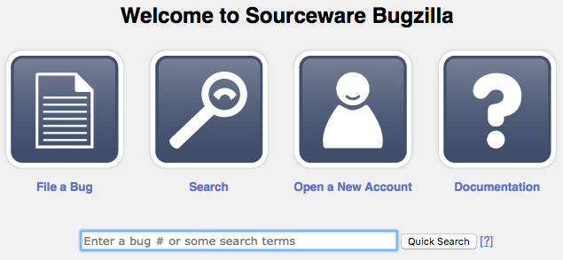


Vulnerability Reports Help Identify Vulnerabilities
White-hat Hacker
Released
Publicly
Security Analysts
CVE Website
Vulnerability Reporting
Security Researchers
Vulnerability Reproduction
……
Regular User
The Crowd
Vulnerability Reporting Websites
Software Developers
Notes:
Nowadays anyone on the Internet could identify and report security vulnerabilities. And software vendors, like Google and Microsoft are spending millions of dollars on their “bug bounty” programs to reward vulnerability reporters. After vulnerabilities are publicly released, reporters usually request an ID from CVE website to further raise community awareness. Following the vulnerability reports, software developers reproduce and identify the existence of vulnerabilities.

Slide 11
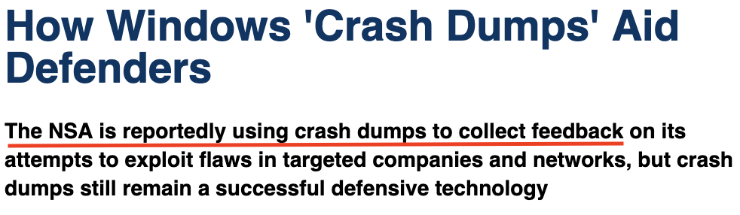

Software Crash Reports Help Disclose Vulnerabilities
Notes:
To help discover more security vulnerabilities, software vendors usually design one software component, responsible for collecting software crash information. For example, Windows Error Reporting, Ubuntu Apport crash report, Mozilla Crash Reporter, Google Chrome Crash Reports. Meanwhile, Websense Lab publishes one technical report and shows that crash dumps aid software developers in software failure debugging, and Windows crash reports help detect some unknown vulnerabilities.

Slide 12
RoadMap
Background & Motivation
Vulnerability Diagnosis
Understanding the Reproducibility of Vulnerabilities (USENIX Security‘18)
POMP: Hardware-assisted Software Crash Analysis (USENIX Security’17)
Other Research
Conclusion & Future Work
Notes:
For each software failure, we diagnose vulnerability following two steps: First, software developers try to reproduce and identify vulnerabilities following the reports; Second, software developers diagnose the root causes of those vulnerabilities. However, the vulnerability reproduction, as a critical early step for vulnerability patching, has not been well understood. Meanwhile, it is hard to diagnose software failures since software vendors may receive million reports every day and those reports only have limited information. Next, let us dive into each work for more details.

Slide 13
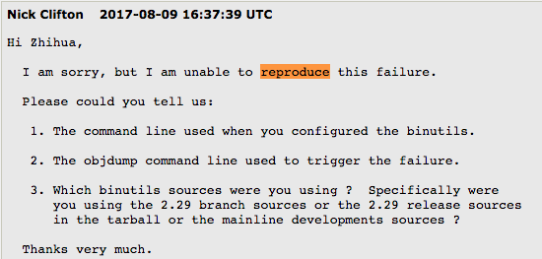
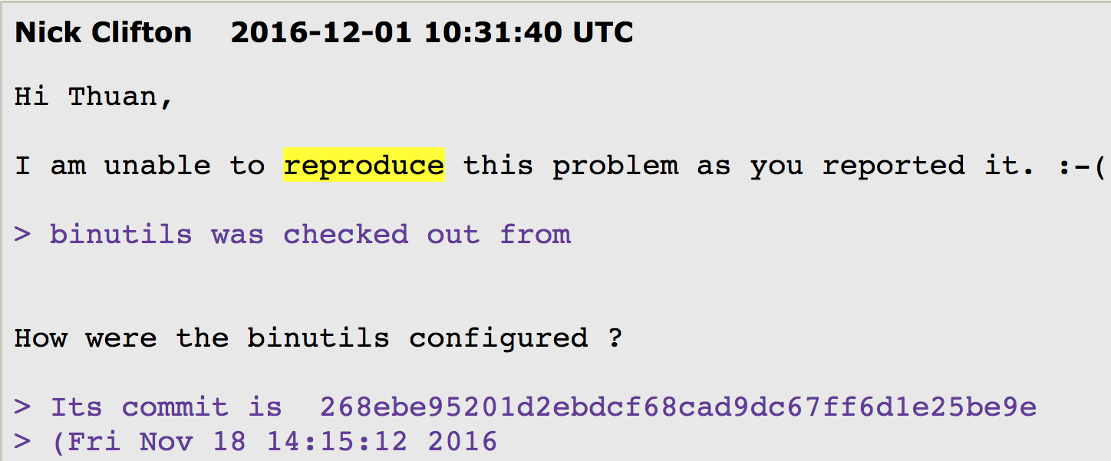
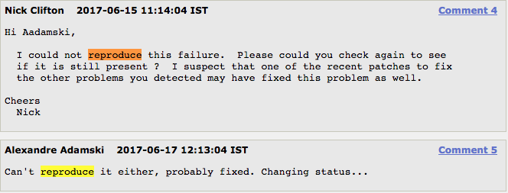
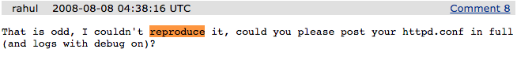
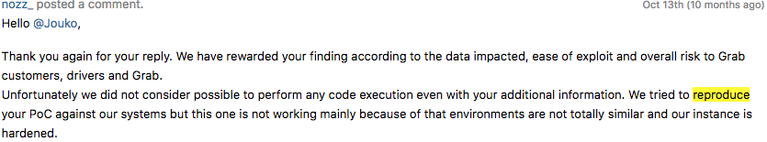
Vulnerability Reproduction Can be Challenging
Notes:
Despite the large number of crowd-reported vulnerabilities, some evidence asserts the poor quality of vulnerability reports. Many software developers complain they cannot reproduce the vulnerabilities. And a non-reproducible vulnerability is more likely to be ignored, which leaves software vulnerable and cause further damage. As a result, those non-reproducible vulnerabilities need more detailed information, more time to be fixed.

Slide 14




Consequences of Poor Reproducibility
Poor reproducibility delays the patching of vulnerabilities
Software vendors
Poor reproducibility prevents analysts from assessing potential threats to their customers in a timely fashion
Security Firms
Poor reproducibility makes it hard to thoroughly evaluate security solutions
Security Researchers
Notes:
Therefore, poor reproducibility seriously delays the patching of vulnerabilities. Apart from software vendors, security community including security analysts and security researchers are also bothered by this problem. For security firms, poor reproducibility really prevents analysts assessing potential threats to their customers in a timely fashion. For our security researchers, poor reproducibility makes it hard to thoroughly evaluate our security solutions.

Slide 15
This Work
Q1: How reproducible are public security vulnerability reports?
Q2: What makes vulnerability reproduction difficult?
Q3: How to improve the efficiency of vulnerability reproduction?
We answer three questions by manually reproducing vulnerabilities
Notes:
So, in this work, we seek to answer three questions: <repeat questions>.To answer these three questions, our method is manually reproducing vulnerabilities. By reproducing vulnerability, I mean using the information in vulnerability reports to trigger the vulnerability.

Slide 16
Vulnerability Report Dataset
We randomly selected a large collection of reported vulnerabilities
We focused on Memory Error Vulnerabilities due to their high severity (Average CVSS Score 7.6 > Overall Average CVSS Score 6.2) and significant real-world impact
We focused on Open Source Linux Software due to debugging and diagnosing capabilities
We collected two datasets including,
A primary dataset of 291 vulnerabilities with CVE IDs
A complementary dataset for 77 vulnerabilities without CVE ID
CVSS Score | Rating
0.1 - 3.9 | Low
4.0 - 6.9 | Medium
7.0 - 8.9 | High
9.0 - 10.0 | Critical
Notes:
We randomly selected a large collection of reported vulnerabilities for our study.
We focused on Memory Error Vulnerabilities due to their high severity and significant real-world impact. We choose Open Source Linux Software due to debugging and diagnosing capabilities.
Finally, we obtained two datasets, including 291 CVEs and 77 Non-CVEs.

Slide 17
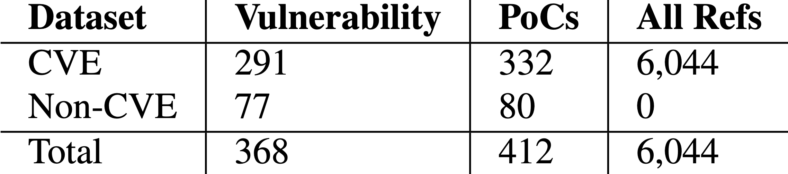
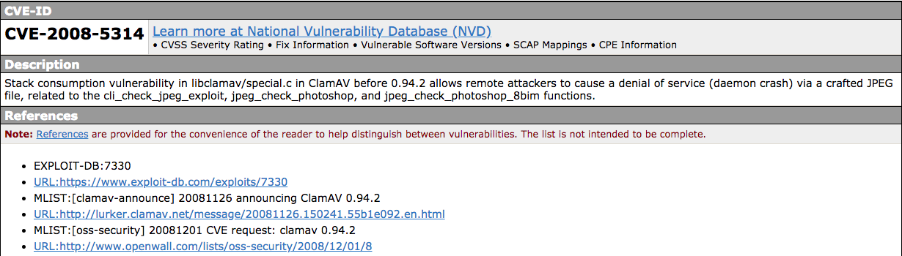
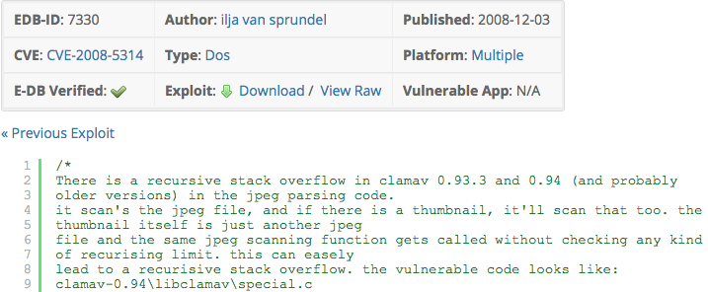
Vulnerability Report Dataset (cont.)
For each vulnerability, we collect vulnerability reports by crawling the references listed in the CVE website
Information source website
CVE-2008-5314
The crowd-sourced vulnerability reports
Notes:
Basically, for each vulnerability, we collect vulnerability reports by crawling the references listed in the CVE website. The references or cited websites are referred as information source websites or simply source websites. The source websites provide detailed technical reports on each vulnerability. We consider these technical reports on the source websites as the crowd-sourced vulnerability reports for our evaluation. Finally, we collect more than 6 thousand vulnerability reports.

Slide 18









Reproduction Workflow
Read
Reports
Set up Environment
Install & Config Software
Trigger Vulnerability
Verify
Vulnerability
Vulnerable Version
Operating System
Software Installation
Software Configuration
Proof-of-Concept File
Trigger Method
Vulnerability Verification
Domain Expert
Notes:
The whole reproduction workflow is to read reports, setup environment, install and configure vulnerable software, trigger the vulnerability and verify the vulnerability. The first step is to retrieve report information. Our security researchers extract useful information from vulnerability reports. However, in practice, the reporters may miss some “common sense” information. To account for this, we develop a set of default settings when corresponding information are not available in the reports.

Slide 19

Reproduction Workflow (cont.)
Read
Reports
Set up Environment
Install & Config Software
Trigger Vulnerability
Verify
Vulnerability
Set up the operating system for vulnerable software analysis
Vulnerable Version
Operating System
Software Installation
Software Configuration
Proof-of-Concept File
Trigger Method
Vulnerability Verification
Information | Default Setting
Operating System | A Linux system that was released in (or slightly before) the year when the vulnerability was reported
Notes:
In the second step, we setup the operating system for vulnerable software analysis. If this information is missing, the default option is a Linux system that was released in (or slightly before) the year when the vulnerability was reported.

Slide 20
Reproduction Workflow (cont.)
Read
Reports
Set up Environment
Install & Config Software
Trigger Vulnerability
Verify
Vulnerability
Compile vulnerable software with the compilation options
Install vulnerable software with the configuration options
Vulnerable Version
Operating System
Software Installation
Software Configuration
Proof-of-Concept File
Trigger Method
Vulnerability Verification
Building System | Default Setting
automake | make; make install
autoconf & automake | ./configure; make; make install
cmake | mkdir build; cd build; cmake ../; make; make install
Notes:
In the third step, we compile and install vulnerable software based on information in the report. If software installation is missing, we provide default options based on building system of vulnerable software.

Slide 21
Reproduction Workflow (cont.)
Read
Reports
Set up Environment
Install & Config Software
Trigger Vulnerability
Verify
Vulnerability
Trigger the vulnerability by using the Proof-of-Concept File
Vulnerable Version
Operating System
Software Installation
Software Configuration
Proof-of-Concept File
Trigger Method
Vulnerability Verification
Type of PoC | Default Setting
Shell commands | Run the commands with the default shell
Script program (e.g., python) | Run the script with the appropriate interpreter
C/C++ code | Compile code with default options and run it
A long string | Directly input the string to the vulnerable program
A malformed file (e.g., jpeg) | Input the file to the vulnerable program
Notes:
In the fourth step, we trigger the vulnerability with PoC File based on trigger method in the report. If trigger method is missing, our default setting varies with the type of PoC File. For example, if PoC is a long string, our default option is directly to input the string to the vulnerable program.

Slide 22
Reproduction Workflow (cont.)
Read
Reports
Set up Environment
Install & Config Software
Trigger Vulnerability
Verify
Vulnerability
Verify the vulnerability with expected program behavior
Vulnerable Version
Operating System
Software Installation
Software Configuration
Proof-of-Concept File
Trigger Method
Vulnerability Verification
Information | Default Setting
Vulnerability Verification | Unexpected program termination (or program “crash”)
Notes:
In the fifth step, we observe the program behavior and verify vulnerability with expected behavior. Since we deal with memory error vulnerabilities, the default setting is unexpected program termination (or program “crash”).

Slide 23

Reproduction Experiment: controlled information source
Exploit DataBase
SecurityFocus
SecurityFocus
SecurityFocus
Exploit DataBase
Exploit DataBase
Redhat Bugzilla
Failure
SecurityTracker
OpenWall
OpenWall
OpenWall
SecurityTracker
SecurityTracker
One of Top 5 Source Websites
Redhat Bugzilla
Redhat Bugzilla
Manual Debugging
……
Success
Single-source
Combined-top5
Combined-all
Notes:
To examine the quality of information from different sources, we have three controlled information sources. First, we only use one of top 5 source websites to reproduce vulnerability; if it fails, we combine information in top 5 source websites; if it still fails, we combine all the CVE references. If it still fails, we take it as a failure case. The success in any information source denotes a success case. All three information sources will follow the previous reproduction workflow. For one failure case, we will resort to manual debugging to figure out the reasons why it failed.

Slide 24
Finding 1: Vulnerability is difficult to reproduce
Information Source | CVE Reproduction (N=291)
 | Covered CVE IDs | # of Reproducible Cases | Success Rate (%)
SecurityFocus | 256 | 32 | 12.6%
Redhat Bugzilla | 195 | 19 | 9.7%
ExploitDB | 156 | 46 | 29.5%
OpenWall | 153 | 67 | 43.8%
SecurityTracker | 89 | 4 | 4.5%
The single-source returns a low success rate
“Combined-top5” has clearly improved the success rate
Combined-top5 | 287 | 126 | 43.9%
Combined-all | 291 | 182 | 62.5%
The success rate is improved to 62.5% by “Combined-all”
Information Source | Non-CVE Reproduction (N=77)
Combined-all | 77 | 20 (25.6%) | 25.6%
Notes:
Our first finding is that vulnerability is hard to reproduce. The experiments take 5 security researchers about 1600 man-hours to finish. We leverage Success Rate to measure reproducibility. Take SecurityFocus as example. Out of 291 CVE entries, SecurityFocus covers 256 CVE IDs. We successfully reproduce 32 vulnerabilities. So the Success Rate is about 13%. And we can see : <repeat observation>. After combining top 5 source websites, it shows “Combined-top5” has clearly improved the success rate. After we combine all the CVE References, the Success Rate is improved to 62.5%.
However, for the whole dataset, even we combine all the CVE References, there are still less than 20 cases that have complete information. So we can infer our default setting works well in the reproduction.

Slide 25
Finding 2: Key Factors makes reproduction difficult
Information | # of vulnerabilities addressed by Manual Debugging
Trigger Method | 74
Software Installation | 43
PoC File | 38
Software Configuration | 6
OS information | 4
Software version | 1
Vulnerability Verification | 0
Some ad-hoc techniques based on experience
Debugging the software and PoC files
Inspecting and modifying the source code
Testing the cases in multiple OS and versions
Searching related hints from the Internet
In those vulnerabilities, 74 cases failed on Trigger Method, 43 cases failed on Software Installation
Notes:
The second finding is that some missing key factors makes vulnerability reproduction difficult. Through intensive manual debugging in table, yet another 2,000 man-hours, we successfully reproduced another 151 vulnerabilities, increasing the success rate to 96%. In those vulnerabilities, 74 cases failed on Trigger Method, 43 cases failed on Software Installation. This table shows the key factors that make vulnerability reproduction difficult are trigger method, software installation and PoC File.

Slide 26
Finding 3: Useful Tips for Information Recovery
Given a failed case, the key question is which piece of information is problematic and how to recover it
Priority of Information
1. Trigger method
2. Software Installation
3. PoC File
Correlation of Different Vulnerabilities
Recover missing information by reading reports of other similar vulnerabilities.
Infer key information with existing information
Recover missing information based on the analysis on the existing information.
Notes:
Given a failed case, the key question is which piece of information is problematic and how to recover it. However, there is no good method to resolve this question. However, instead of picking a random information category for in-depth troubleshooting, we prioritize information categories in above order. It means you can first assume trigger method is problematic and check another trigger method to reproduce the vulnerability. And correlation of different vulnerabilities is surprisingly useful. In other word, it is helpful to recover missing information by reading reports of other similar vulnerabilities. Another interesting tip is to infer some key information with existing information. For example, we could figure out the compilation options by analyzing code segments in the core dump.

Slide 27
Data Sharing
DataSet : https://vulnreproduction.github.io/
Github Repo : https://github.com/VulnReproduction/LinuxFlaw
For each vulnerability, we have the following information:
Structured information fields (in HTML and JSON)
Detailed instructions on how to reproduce the vulnerability
Fully-tested Proof-of-Concept
Pre-configured virtual machine or Docker Image
Notes:
We have opened source our dataset in this GitHub repository. And you could follow our instructions to reproduce vulnerabilities or directly try them in our prepared virtual machines. To the best of our knowledge, this is the largest public ground-truth dataset of real-world vulnerabilities which were manually reproduced and verified

Slide 28
Summary
Read
Reports
Set up Environment
Install & Config Software
Trigger Vulnerability
Verify
Vulnerability
Vulnerability reproduction is difficult and requires extensive manual efforts
Our crowdsourcing approach could increase the reproducibility of vulnerabilities
Apart from manual debugging based on experience, and some heuristics could help recover missing information
Notes:
Our conclusion is as follows: <repeat conclusion>.
Finally, there is an urgent need to automate vulnerability reproduction and overhaul current vulnerability reporting systems.

Slide 29
RoadMap
Background & Motivation
Vulnerability Diagnosis
Understanding the Reproducibility of Vulnerabilities (USENIX Security‘18)
POMP: Hardware-assisted Software Crash Analysis (USENIX Security’17)
Other Research
Conclusion & Future Work
Notes:
Next, let us dive into those two works.

Slide 30

It’s Hard to Automatically Diagnose Software Crashes
Google, Microsoft , Mozilla, Ubuntu and etc. receive millions software crashes reports every day
There is only a few information attached in the crash reports
……
The global cost of debugging software has risen to $312 billion annually
It is Difficult, but Urgent to automatically diagnose the root causes of software crashes
Notes:
Although crash reports can be used to detect new vulnerabilities, it is hard to automatically analyze those crash reports. One reason is software vendors like Google, Microsoft may receive millions reports of software crashes every day. Another reason is, there is only a few information attached in the crash reports. Meanwhile, debugging software cost has risen to $312 billion per year globally. Therefore, automatic root cause analysis on software crash is difficult, but urgent.

Slide 31
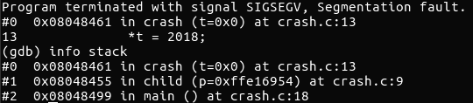
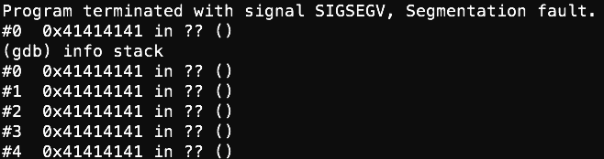
Technical Challenges in Analyzing Software Crashes
In general, a core dump carries information, such as
Memory snapshot
Registers
Others (e.g., signals received)
Security Vulnerability (e.g., memory corruption vulnerability) damages some information in the core dump
Corrupted Crash Site
Corrupted Stack Trace
Unreliable Memory Value
Notes:
In the slide, I will present two technical challenges in analyzing software crashes caused by Security Vulnerability. First, there is only a few information in the crash reports. Generally speaking, we only have a core dump file, which usually contains memory snapshot, registers at crash time. Second, security vulnerabilities, especially memory corruption vulnerability, damages information left in the core dump, which leads to corrupted crash site, corrupted stack trace, unreliable memory data. From the right figure, we can figure out, the crash site and stack trace already corrupted.

Slide 32
POMP: Hardware-assisted Software Crash Analysis
Memory
Registers
Signal ....
Memory
Core dump
Registers
Hardware Trace
A1: mov eax, [ebp+0x8]
A2: add eax, 0x4
A3: mov [eax], 0x2; Root Cause
A4: mov eax, 0x0
A5: pop ebp
Signal ...
Hardware-enhanced
Core dump
Hardware Trace
POMP
Vulnerable Instructions
Executable
Notes:
To diagnose software failure under those challenges, I developed a technical tool named POMP. It takes hardware-enhanced core dump(including not only normal core dump, but also hardware trace) and the executable of software system, then output the vulnerable instructions that contribute to the software crash.

Slide 33
Hardware-enhanced Core dump
Intel Processor Tracing is a hardware feature in the new generations of Intel processors, which enables security analysts or software developers to trace program execution with nearly no overhead
Core dump + Hardware trace = Hardware-enhanced Core dump
It unveils not only a crashing state but more importantly captures the control flow a crashing program follows
Memory
Registers
Hardware Trace
Signal ...
Notes:
First, let me describe a hardware feature. Intel Processor Tracing is a hardware feature in the new generations of Intel processors, which enables security analysts or software developers to trace program execution with nearly no overhead. We integrate hardware trace from Intel PT into core dump when software crashes or terminate abnormally, which forms hardware-enhanced core dump. It unveils not only the crashing state but more importantly captures the control flow. We extract the executed instructions from the logged hardware trace.
In order to catch the root cause of a software crash, the next step is to reconstruct the data flow from the hardware-enhanced core dump.

Slide 34
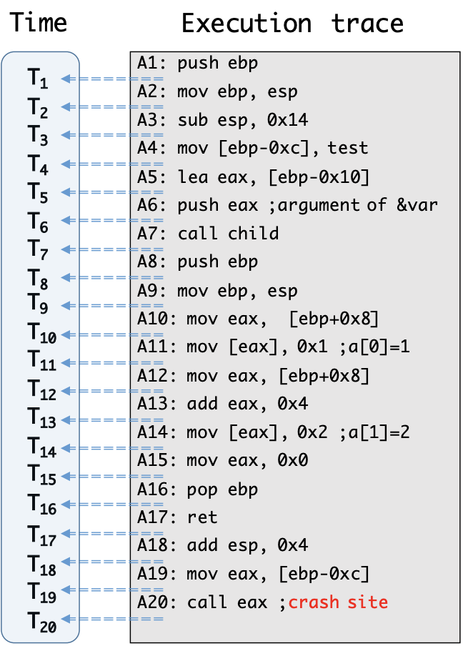
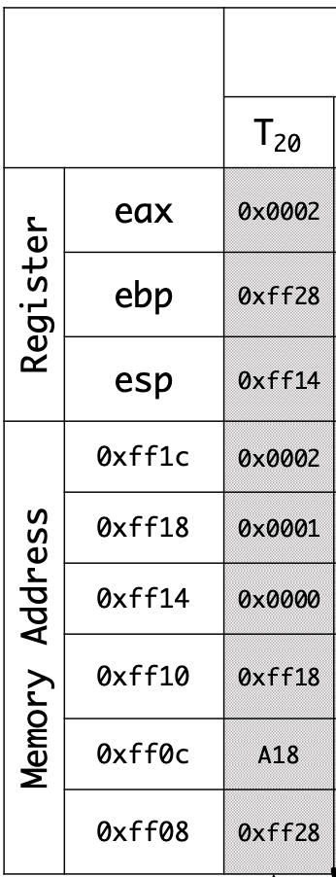
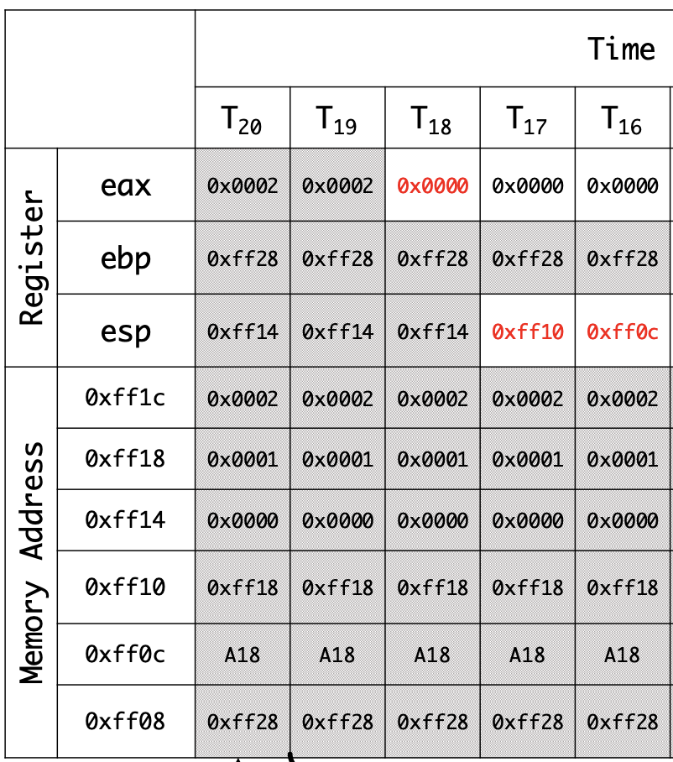
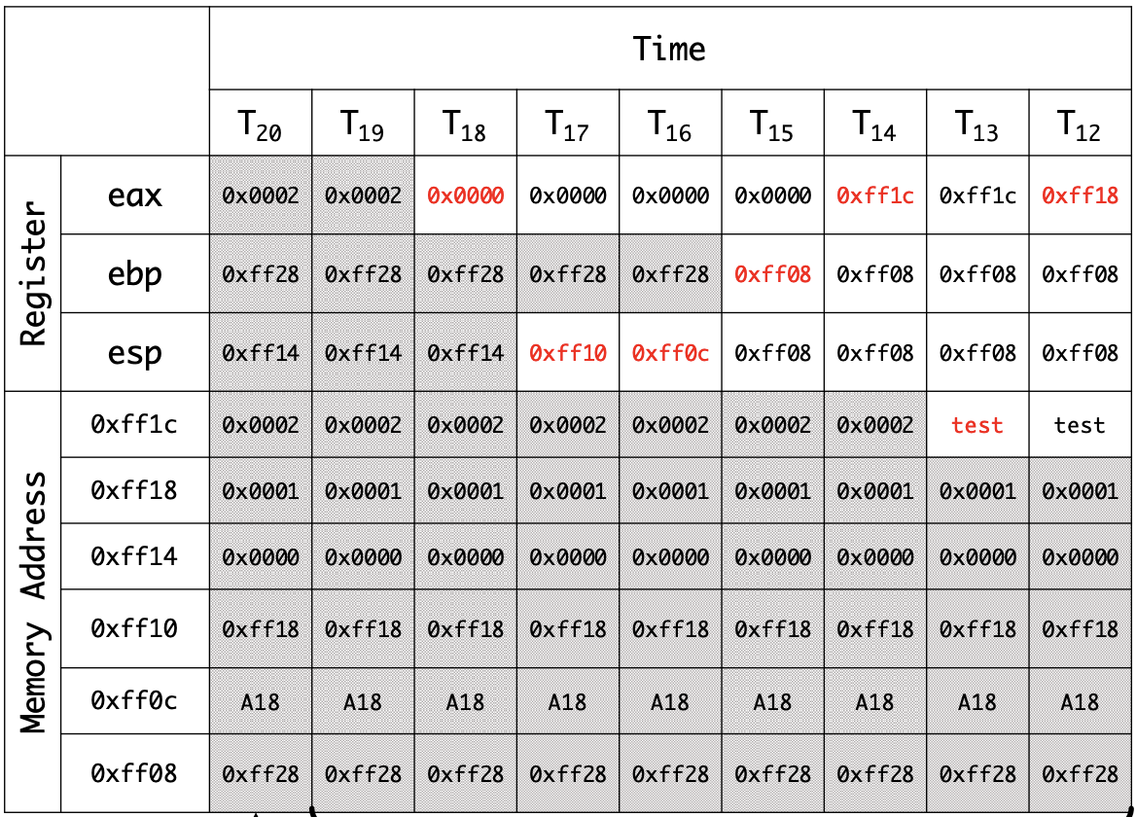
Data Flow Construction
Reverse Execution
Reversely execute the crashing trace starting from the crash site
Reconstruct the data flow that a program followed prior to its crash
Memory
Registers
Hardware Trace
……
……
Signal ...
Crashing State
Partial Recovered Execution State
Recovered Execution State
Notes:
In this work, we propose a novel technique - reverse execution. Our reverse execution takes the crashing state in core dump as the starting state, and then reversely execute the instructions prior to the crash site. Finally it could reconstruct the data flow before program crash. In the next, I will give more details about reverse execution and the challenges we solved.

Slide 35
Reverse Execution
For one instruction – ins:
Forward Execution
f_{ins}: S_{before} → S_{after}
For example,
S_{before}: eax = 0x8
ins: add eax, 0x8
S_{after}: eax = 0x10
Reverse Execution
f’_{ins}: S_{after} → S_{before}
For example,
S_{after}: eax = 0x10
Inverse ins: sub eax, 0x8
S_{before}: eax = 0x8
Notes:
For an instruction - ins, its execution can be modelled as a function, which transfers the before-state to after-state. Reverse execution of this instruction is to find its inverse function, which rollbacks the after-state to the before-state. For instance, the inversion function of addition instruction is the subtraction instruction. Reverse execution for such instructions are straightforward. However, not all the instructions have inverse function.

Slide 36
Challenge – Non-invertible Instructions
Reverse Execution
f’_{ins}: S_{after} --> S_{before}
S_{after}: eax = 4
ins: mov eax, 4
S_{before}: eax = ?
Reverse Execution
f’_{ins}: S_{after} --> S_{before}
S_{after}: eax = 0
ins: xor eax, eax
S_{before}: eax = ?
More non-invertible instructions: shr, shl, and, or ……
Notes:
For moving instruction, we don’t know its inverse function. In other words, the value of eax in before-state is unknown. More complicatedly, the inverse function of some instructions is decided by the operands. Apart from those instructions, there are more non-invertible instructions.

Slide 37
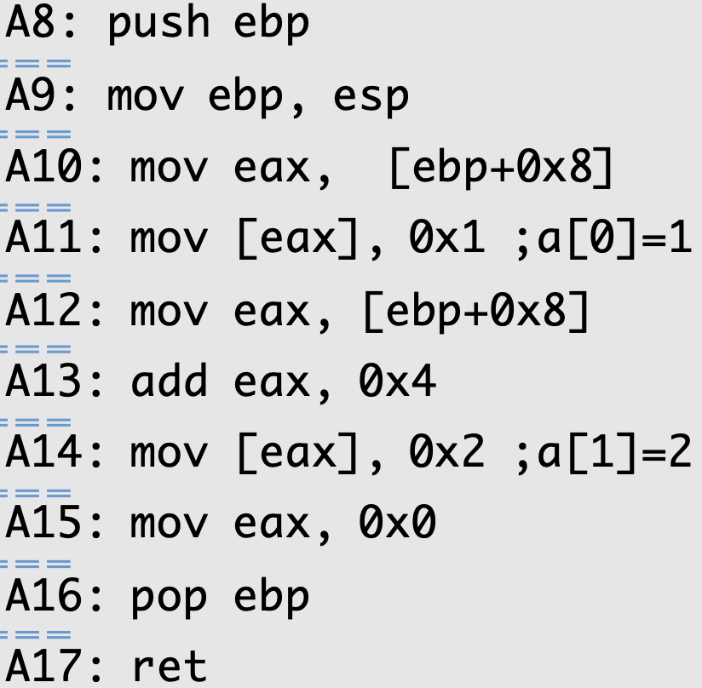
Solution – Data Flow Relation
S_{after}: ebp = 0xff08
ebp, esp are not changed
S_{before}: ebp = ? → ebp = 0xff08
esp = 0xff08
mov ebp, [esp]
add esp, 4
Notes:
To address this challenge, our solution is to rely on data flow analysis. Let’s look at this example. To explain clearly, I simplify Instruction A16 into two simple instructions. As we know, add is an invertible instruction, but mov is a non-invertible instruction. So after reversely executing this instruction, we could infer, in the before-state, esp is known, but ebp is unknown. In our solution, we keep ebp unknown and continue reverse execution. When we reach A9, we could get the value of ebp in the after-state since esp is unchanged between two instructions. Finally, in this case, we rely on the define and use relations of ebp, to overcome the challenge. However, in practice, data flow analysis is much more complicated, which introduces another challenge.

Slide 38
Challenge - Memory Alias Problem
S_{before}: [ebp+0x8] = [0xff10] = ?
S_{after}: eax = ?, [eax] ???
[0xff10] is unchanged???
eax@A14 =? ebp+0x8@A12
S_{before}: eax = ?
Notes:
Another challenge is memory alias problem. Also in this example, instruction A15 is non-invertible, which causes eax unknown in the before-state. To recover this value, we follow the previous solution and find this value can be derived from instruction A12. More specifically, if we know the value of eax after instruction A12, we can add it with 4 to get the value of eax before instruction A15.
We leave eax unknown and continue reverse execution. So [eax] at instruction A14 is an unknown memory cell. In other words, we don’t know where it writes 2 to. When we reach A12, mov instruction copies a memory cell with (address 0xff10) to eax. So the question becomes “what’s the value of [ebp+0x8]”? Or we could fetch the value of [0xff10] memory from A15?
The answer is that it depends on whether [eax] modifies this specific memory cell. If not, we can fetch the value and resolve the unknown eax. So we need to understand the alias relationship between those two memory references, namely if eax at instruction A14 equals to ebp+0x8 at instruction A12.

Slide 39
Solution - Hypothesis Testing
Make two hypotheses for each pair of memory (Alias and Non-alias)
Test each of the hypotheses by emulating inverse operations for instructions, and reject the hypothesis when encountering conflicts
Alias
Continue Reverse Execution with
eax@A14 == ebp@A12+0x8
Memory alias:
[eax]@A14 & [ebp+0x8]@A12
Reject
Reverse Execution
Snapshot
Non-alias
Continue Reverse Execution with
eax@A14 != ebp@A12+0x8
Notes:
To resolve the memory alias problem, we propose a technique called hypothesis testing. When we encounter the above memory alias during reverse execution, we take a snapshot of current reverse execution state. Then we make two hypotheses. One assumes they are alias, and the other assumes the opposite. Then we continue the reverse execution under two hypotheses, respectively. If reverse execution runs into conflict, we know the corresponding hypothesis does not hold. For instance, the alias hypothesis encounters conflicts in this example. Then we feed back this information to the snapshot and resume the normal reverse execution with the accurate alias relation.

Slide 40
Backward Taint Analysis
Backward Taint Analysis
Figure out why a bad value was passed to the crash site
Notes:
To locate the root causes, we use a technique called backwards tainting. To be more specific, we firstly identify the bad data that leads to the crash, and then track backwards the propagation of the data. Each instruction contributed to the propagation is highlighted and the vulnerability is typically enclosed in those instructions. We did not further attempt to pinpoint exact location of the vulnerability, but we believe this goal can be achieved via inspecting which instructions violate the patterns of program safety.

Slide 41
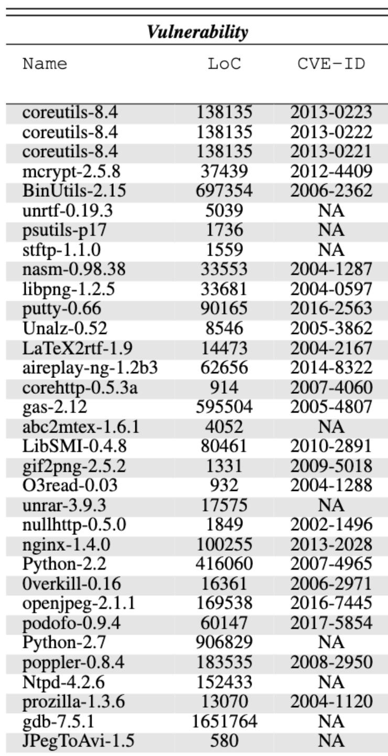
Evaluations
33 vulnerabilities resulting in the crashes
Stack Overflow/Heap Overflow/Use-after-free
Null Pointer ……
30 different crashing programs
CoreUtils
BinUtils
Notes:
To demonstrate the utility of POMP, we collected 33 software crashes which are caused by both security bugs and non-security vulnerabilities. The 30 software we selected cover different complexity levels, ranging from gdb to jpegtoavi.

Slide 42
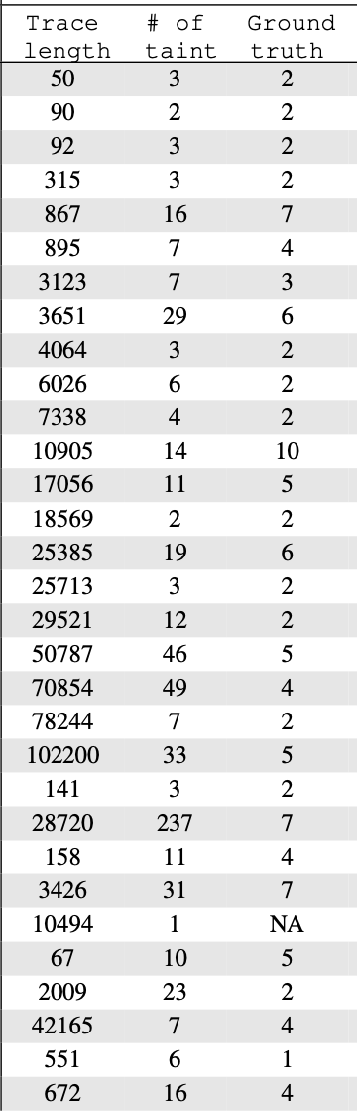
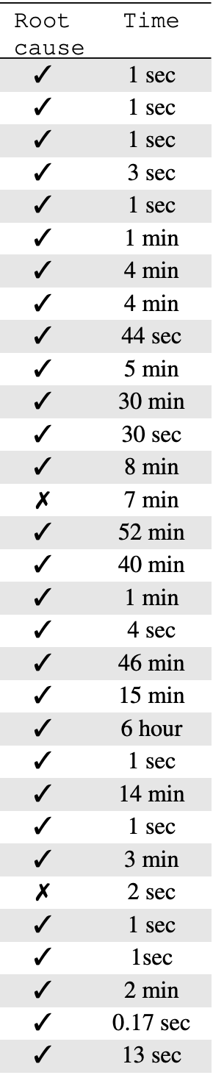
Evaluations (cont.)
Effectiveness
POMP can accurately locate the underlying vulnerabilities and enclose them in a small set of instructions (less than 10 instructions)
Efficiency
POMP only takes seconds or minutes to diagnose most software crashes
Notes:
We evaluate POMP from two aspects. For the effectiveness, POMP can accurately locate the underlying vulnerabilities and enclose them in a small set of instructions (less than 10 instructions). For the efficiency, POMP only takes seconds or minutes to diagnose most software crashes.

Slide 43
Summary
Memory
Reverse
Execution
Backward Taint analysis
A1: mov eax, [ebp+0x8]
A2: add eax, 0x4
A3: mov [eax], 0x2; Root Cause
A4: mov eax, 0x0
A5: pop ebp
Registers
Hardware Trace
Signal ...
Hardware-enhanced Core dump
Recovered Program State
Vulnerable Instructions
POMP could leverage reverse execution to recover the previous program state for further crash diagnosis
POMP can significantly downsize the program statements that a software developer needs to manually examine
Notes:
To be summarized, with the help of hardware-enhanced core dump, POMP firstly performs reverse execution to recover the program state, and then uses backward taint analysis to locate the vulnerable instructions. Through our evaluation, we demonstrate that POMP can restore program state for further crash diagnosis. It can also significantly downsize the program statements that a software developer needs to manually examine.

Slide 44
RoadMap
Background & Motivation
Vulnerability Diagnosis
Understanding the Reproducibility of Vulnerabilities (USENIX Security‘18)
POMP: Hardware-assisted Software Crash Analysis (USENIX Security’17)
Other Research
Conclusion & Future Work
Notes:
Next, let us dive into those two works.

Slide 45
Other Research
Facilitate Automatic Root Cause Diagnosis with Program Analysis
CREDAL: Towards Locating a Memory Corruption Vulnerability with Your Core Dump (ACM CCS’16)
POMP++: Facilitating Postmortem Program Diagnosis with Value-set Analysis (TSE’19)
Facilitate Automatic Root Cause Diagnosis with Deep Learning
DEEPVSA: Facilitate Value-set Analysis with Deep Learning (USENIX Security’19)
RENN: Efficient Reverse Execution with Neural-Network-assisted Alias Analysis (ASE’19)
Explainable Deep Learning for Cybersecurity
LEMNA: Explaining Deep Learning based Security Applications (ACM CCS’18 Outstanding Paper)
Notes:
Apart from those research works, I have some research which combines deep learning, program analysis with security.
First, we develop deep neural networks to learn the relationship between binary instructions and corresponding memory regions, and finally utilize the predicted region information to assist conventional VSA in memory region identification. Second, we develop more explainable deep learning models for Cybersecurity and make security analysts establish trust with those AI techniques. It is noteworthy, our LEMNA received ACM CCS Outstanding Paper Award.

Slide 46
RoadMap
Background & Motivation
Vulnerability Diagnosis
Understanding the Reproducibility of Vulnerabilities (USENIX Security‘18)
POMP: Hardware-assisted Software Crash Analysis (USENIX Security’17)
Other Research
Conclusion & Future Work
Notes:
Finally, I will conclude my research works and present some of my future works.

Slide 47
Conclusion
It’s important, but difficult to diagnose software failures reported by the Crowd
Vulnerability reproduction and Software crash analysis could help software developers locate the root causes of software failures effectively and efficiently
Vulnerability Discovery and Vulnerability Diagnosis could facilitate the removal of security vulnerabilities, reducing possible cyberattacks and further damages
Notes:
Finally, to conclude my research work, <conclusion>

Slide 48
Future Work
Vulnerability Discovery
Vulnerability Diagnosis
Vulnerability Patching
Vulnerability Reporting
Information in Vulnerability Reports
Automatic Vulnerability Reproduction
Vulnerability Reports
Software Crash
Patch Quality Assurance
Vulnerabilities fixed without reproduction
More platforms
More emerging techs
Notes:
Despite the efforts in the vulnerability removal, there are still some problems in this space, such as automatic vulnerability reproduction, patch quality assurance. Therefore, I will explore more problems in the vulnerability removal process. First, I will explore the possibility of automatic vulnerability reproduction and Patch Quality Assurance. Some hard-to-reproduce vulnerabilities or software failures are manually analyzed and fixed by software developers. Without patch testing, it is irresponsible to deliver those patches to the end-users. From the vertical perspective, I will continue to leverage more emerging techniques(like Reinforcement Learning and Deep Learning in AI, hardware features) to solve some security-critical problems. Meanwhile, I will extend my research of security problems to more platforms, such as IoT.

Slide 49




Acknowledgements
Xinyu Xing
Bing Mao
Peng Liu
Gang Wang
Dawn Song
Lu Long
Chengyu Song
Jun Xu
Wenbo Shen
Ping Chen
Jimmy Su
Yaohui Chen
Alejandro Cuevas
Wenbo Guo
Notes:
Finally, I would like to express my special acknowledgements to all my collaborators. Without their advising, mentoring, and help, it would be extremely hard to achieve my research. Thank you very much for joining my talk.

Slide 50
Practical Issues when applying VSA into Crash Analysis
Memory region that an instruction accesses can be determined by :
Semantics of that instruction
Context indicated by previous instructions
In the context of Software Crash Analysis :
The execution trace in a hardware-enhanced core dump is usually incomplete
Hardware has limited capability in storing all the instructions executed
The ability of VSA in memory alias identification is highly affected
A1: 50 push eax
A1: 8D 1C 24 lea ebx, [esp]
A2: 89 0B mov DWORD PTR [ebx], ecx
Notes:
However, in the real word, VSA cannot accurately pinpoint memory alias as we expect. The reason is as follows.

Slide 51
How to Improve Value-set Analysis?
Memory alias analysis can be simplified as the relationship between instruction sequence and corresponding value-set of memory access, meanwhile, deep learning is good at finding such relationship
Previous applications demonstrated that DL can be used to learn patterns from input and assign each input a label
nop; nop; nop; nop; sub esp, 0x4c;
90 90 90 90 83 EC 4C
Binary Function Start Identification (Usenix Security’15)
Recurrent Neural Network (RNN)
0 0 0 0 1 0 0

Slide 52
DEEPVSA: Facilitate Value-set Analysis with Deep Learning
Instruction trace
Crashing Trace
Predicted Memory Region
Deep Learning Network
Deep Learning Network
Label (Memory region)
Predicted Memory Region
Value-set Analysis
1. Train Deep Learning Network with Training Data Set
2. Predict Memory Region with trained Deep Learning Model
3. Integrate and facilitate VSA with predicted Memory Region

Slide 53
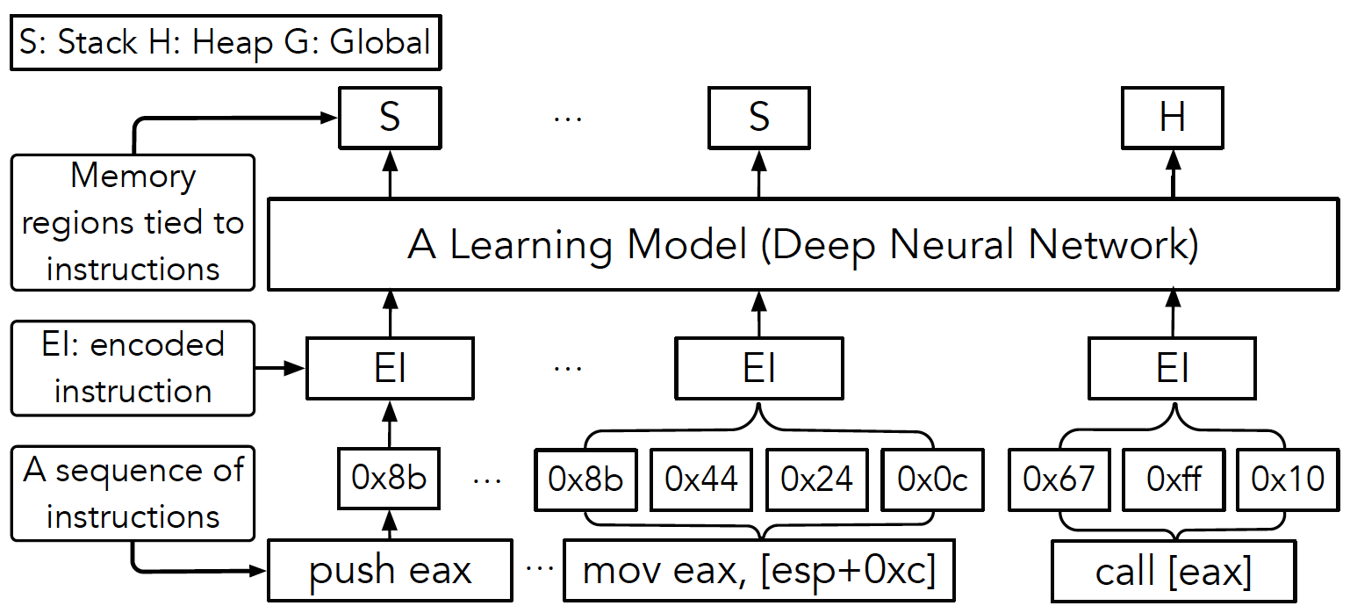
Our Neural Network Architecture

Slide 54
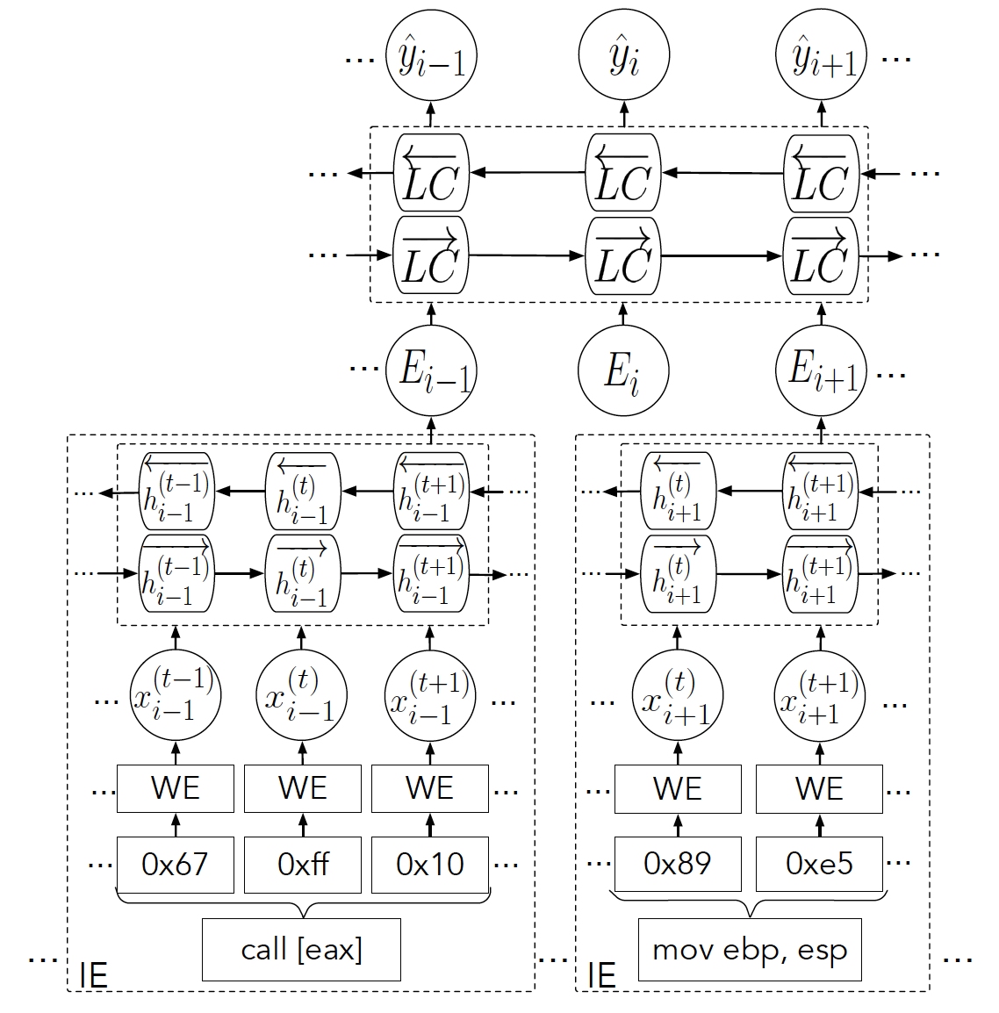
Our Neural Network Architecture (cont.)
Instruction Embedding (IE)
Use a word embedding to encode machine code
Use a bi-directional LSTM to generate instruction embeddings
Identification network
Utilize a bi-directional LSTM to predict the region that an instruction accesses
Bi-directional LSTM
Bi-directional LSTM
Word embedding

Slide 55
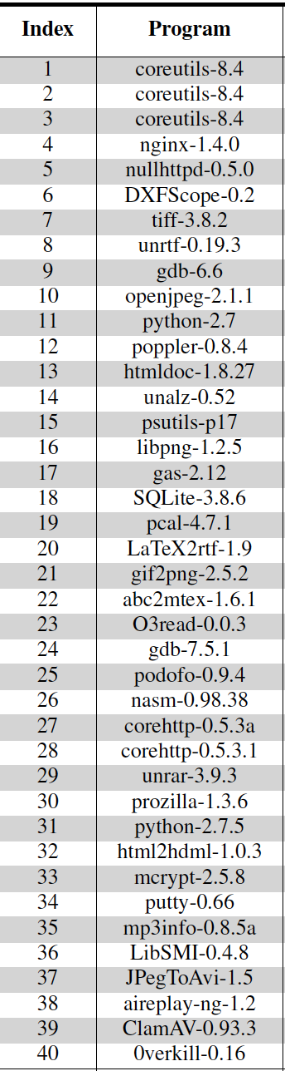
Evaluation
Our Experiment Database includes:
Training set
~50 million lines of instructions and their memory accesses (generated from the test cases of 78 unique programs)
Testing set
~1.6 million lines of instructions and their memory accesses (generated from the PoC programs of 40 real-world vulnerabilities)

Slide 56
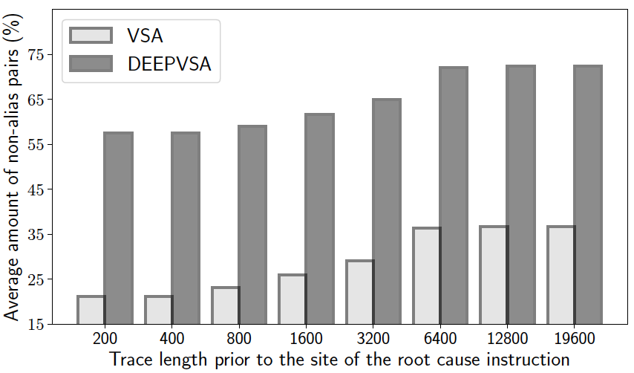
Evaluation (cont.)
Experiment Result
Execution trace length stored in a core dump influences alias analysis
In comparison with VSA, DEEPVSA is more effective in finding the root cause of software crashes
 | DEEPVSA | VSA
Total # of cases backward taint pinpoints the root cause of the software crash | 37/40 | 31/40

Slide 57
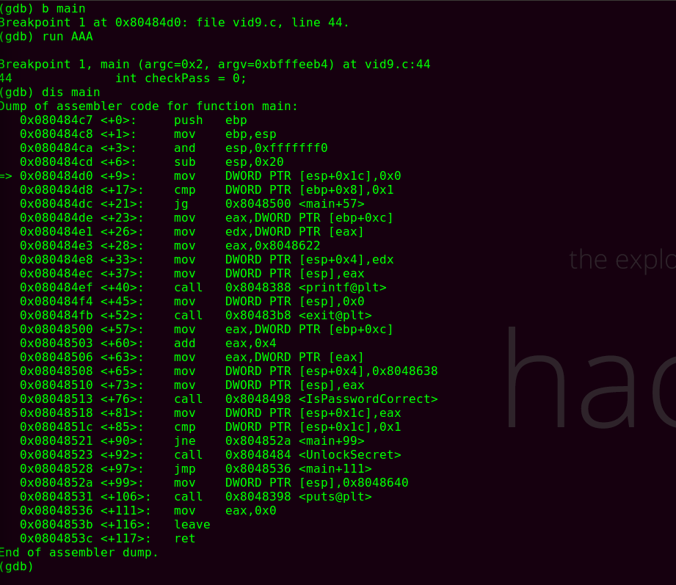
Summary
STACK
HEAP
GLOBAL
Ground Truth
Deep Neural Network
Predicted memory regions
VSA
Conventional VSA suffers from inaccurate alias analysis when an execution trace is incomplete
VSA combined with deep learning (DEEPVSA) could improve memory alias analysis at binary level and thus facilitate software failure diagnosis

Slide 58
Stack Clash
Java Deserialize
Mirai
Double Fetch
Double Kill
2010
2011
2012
2013
2014
2015
2016
2017
2018
2019
Notes:
Emphasize the damage to Software Vendors and Software Users
The most damaging Vulnerability examples (Ten years from 2010 to 2019)
The damage caused by those vulnerabilities
Open source security vulnerabilities start to have their own logo

Slide 59
Future Work
Vulnerability Discovery
Vulnerability Diagnosis
Vulnerability Patching
Automatic Vulnerability Reproduction
Vulnerability Reports
Software Crash
Patch Quality Assurance
Vulnerabilities fixed without reproduction
More platforms
More emerging techs
Notes:
Horizontally, I will explore more problems in those three steps. First, I will explore the possibility of automatic vulnerability reproduction. As mentioned early, many key information related vulnerability reproduction can be missing, such as PoC, compilation options. If PoC is missing, we will try directed fuzzing to guide the execution path to the faulty path, which is more practical than symbolic execution and model checking. If compilation options is missing, we will try to infer compilation options based on some code segments. Through binary diffing, we can figure out whether one option enabled or not by checking the existence of some code in the code segments. Second, I will explore the possibility of Patch Quality Assurance. Some hard-to-reproduce vulnerabilities or software failures are manually analyzed by software developers. And they develop patches purely from their understandings of this vulnerabilities. Without patch testing, it is irresponsible to deliver those patches to the end-users. From the vertical perspective, I will continue to leverage more emerging techniques(like Reinforcement Learning and Deep Learning in AI, hardware features) to solve some security-critical problems. Meanwhile, I will extend my research of security problems to more platforms, such as IoT platform.

Slide 60
Our Findings of Vulnerability Reproduction
Finding 1 : Vulnerability is difficult to reproduce
Finding 2 : Key Factors makes reproduction difficult (Top 3)
Trigger Method
Software Installation
PoC (Proof-of-Concept)
Software Configuration
Finding 3 : Useful Tips for Information Recovery
Priority of Information
Correlation of Different Vulnerabilities
Tools which infer Missing Information from Crash Dump

Slide 61
My Research Focus
Vulnerability Reproduction
Understand the Vulnerability Reproduction (USENIX Security’18)
Software Crash Analysis
POMP: Hardware-assisted Software Crash Analysis (USENIX Security’17)
Notes:
Due to time limit, I will only focus on software crash analysis in the rest of my talk.

